Slide 1




Using External Secondary Data

Slide 2

iClicker Question
Primary data are those collected by the researchers for the research question at hand and secondary data are those collected for other purposes
True
False

Slide 3

iClicker Question
Why do we need to know who sponsor a research study?
Sponsor can have ulterior motives
Knowing the sponsors can help researchers and readers appreciate them more
Both A and B

Slide 4

iClicker Question
What are the original four V’s of big data?
Volume, Velocity, Variety, Veracity
Volume, Valence, Value, Velocity
Volume, Variety, Valance, Veracity

Slide 5
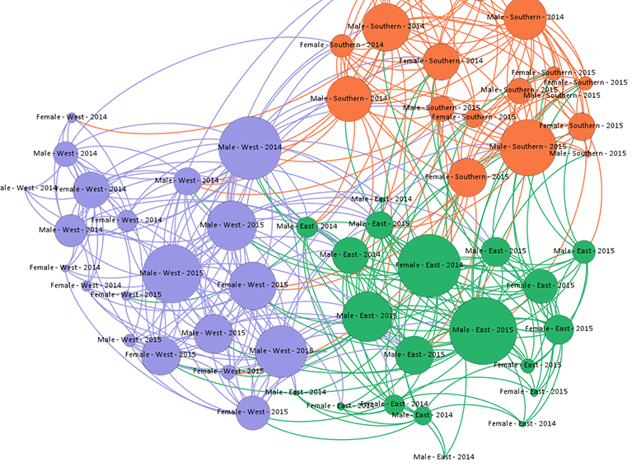
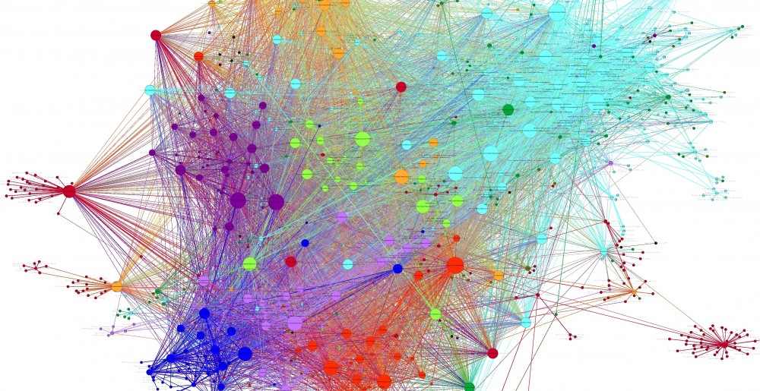
5-min snippet: Social Network Analysis
Notes:
Open Gephi

Slide 6
Recap Last Class
Types of data: primary vs. secondary (internal)
Big Data Introduction
Types of “Big Data” Analyses

Slide 7
Learning Objectives
Describe the process of searching for published external secondary data
List 3 common uses of the information supplied by standard marketing info services
Define geodemography
Describe the use of diary panels and scanner data for assessing product sales
Discuss the purpose and operation of people meters
Define single-source data

Slide 8
Marketing Research Process
In Chapter 7, we shift our focus onto retrieving existing info from external sources. Some of this external info may end up in the company’s Decision Support System; some of it may also be in the form of “big data.”

Slide 9
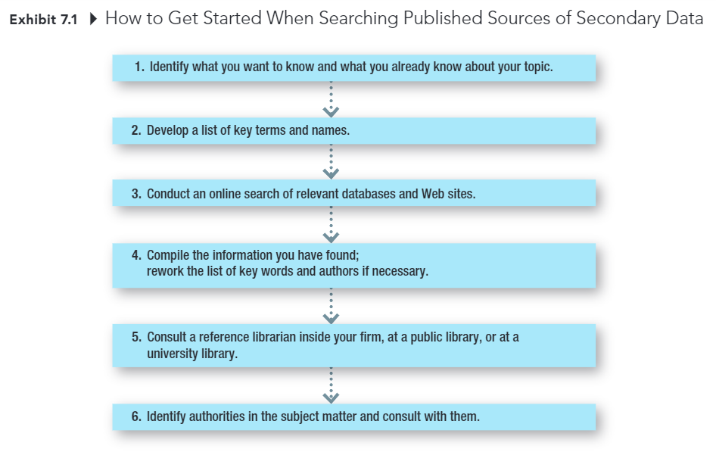
Marketing Research Process

Slide 10
Standardized Marketing Information
Secondary data collected by companies that sell the data to multiple companies, allowing the costs of collecting, editing, coding, and analyzing them to be shared.
Notes:
The data are standardized so that they can be used by multiple companies rather than customized for a specific company

Slide 11
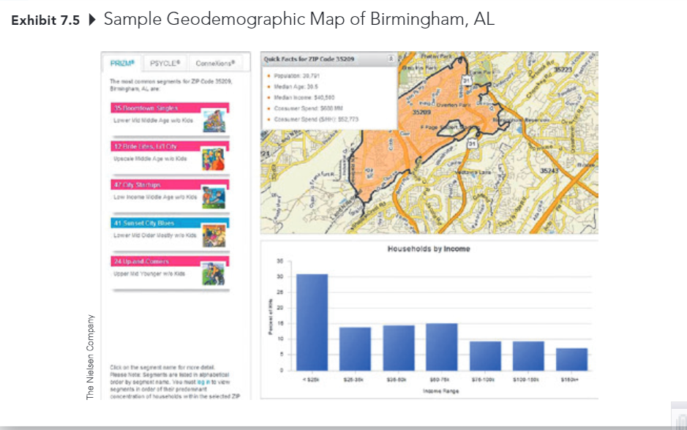
Profiling Customers
Geodemography: the availability of demographic, consumer behavior, and lifestyle data by arbitrary geographic boundaries that are typically quite small.

Slide 12
Measuring Product Sales Market Share
(Online) Diary Panels Scanners

Slide 13
Measuring Advertising Exposure and Effectiveness
Television and Radio
Nielson TV ratings
Arbitron radio ratings
Print Media
Starch Ad Readership (magazine)
Internet
Nielson Digital Voice
ComScore Mobile Metrix
Cross-platform Services
Simmons National Consumer Study
Gfk MRI
comScore, WebTrends, Nielsen

Slide 14
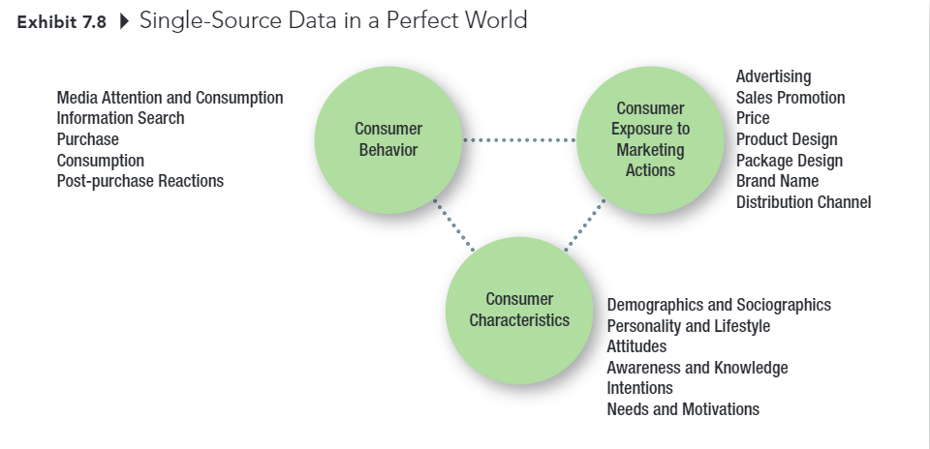
Single-Source Data in a Perfect World

Slide 15
Conducting Causal Research
Notes:
Chapter 8

Slide 16
Learning Objectives
Discuss the three general types of primary data research
Clarify the difference between lab experiments and field experiments.
Explain which of the two types of experiments has greater internal validity and which as greater external validity
List the 3 major considerations in test marketing.
Distinguish between a standard test market and a controlled test market
Discuss the advantages and disadvantages of simulated test marketing

Slide 17
Three types of Primary Data Research
Exploratory Research (explore)
Descriptive Research (describe)
Causal Research (establish cause and effect)

Slide 18
Three Types of Primary Data Research
Exploratory Research: Research conducted to gain ideas and insights to better define the problem or opportunity confronting a manager.
Descriptive Research: Research in which the major emphasis is on describing characteristics of a group or the extent to which variables are related
Causal Research: Type of research in which the major emphasis is on determining cause-and-effect relationships
Notes:
Review

Slide 19
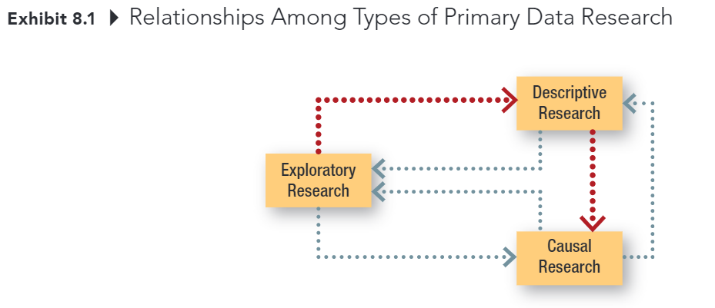
Three Types Primary Data Research
Notes:
This is the only new slide that helps you visualize the relationship among types of research design.

Slide 20

Causal Research
The purpose of causal research is to test cause and effect relationships
condition X causes event Y

Slide 21
Evidence of Causality
Consistent variation – evidence of the extent to which X and Y occur together or vary together in they way predicted by the hypothesis (Correlation condition) spurious correlation
Time order – evidence that shows X occurs before Y
Elimination of other explanations – evidence that allows the elimination of factors other than X as the cause of Y
X – the cause
Y – the effect
Notes:
Correlation does not mean causation.
Even though you can satisfy the first condition, you have to satisfy the other conditions as well in order to establish causal relationship. Hence, many people thought they can
Because we can never know for certain that we have eliminated all other possible causes of an effect, we can never state with certainty that X caused Y.

Slide 22
Types of Test Markets
Market Testing: A controlled experiment done in a limited but carefully selected sector of the marketplace
Standard Test Market: A test market in which the company sells the product through its normal distribution channels.
Controlled Test Market: An entire test program conducted by an outside service in a market in which it can guarantee distribution
Simulated Test Market: A study in which consumer ratings are obtained along with likely or actual purchase data often obtained in a simulated store environment; the data are fed into computer models to produce sales and market share predictions.

Slide 23
Recap

Slide 24
5-min Snippet
Sales Funnel
Customer Segmentation

